Slide 1
CSE7302 - INTERNSHIP Review-5 Presentation HOSPITAL MANAGEMENT SYSTEM
Student Details
Name | Ruchitha M
Roll No | 20221CSE0708
Section | 8CSE9
Under the Supervision of,
Mr. Jerrin jeo Francis
Professor / Associate Professor / Assistant Professor
Presidency School of CSE
Presidency University
Name of the Program: B tech (Computer Science and Engineering)
Name of the HoD: Dr. Asif Mohamed H.B
Name of the Program Internship Coordinator: Mr. S. Shakthi & Dr. R. Balakrishnan
Name of the School Internship Coordinator: Dr. Md Ziaur Rahman

Slide 2
Content
About Company or Organization
Working domain or the technology
About your team and reporting Manager
Challenges Faced in Internship
Objectives of the work
Literature Review
Proposed System
Problem Statement
System Requirements
Advantages of Proposed System/Work
System Design
System Implementation
Internship Roadmap
Github Link

Slide 3
About Company or Organization
Rail Wheel Factory (RWF), Yelahanka, Bengaluru, is a premier production unit of Indian Railways.
RWF plays a vital role in supporting India’s railway infrastructure by adopting modern manufacturing processes along with computerized systems for planning, monitoring, and quality control.
Aiming to bridge classroom learning with industry needs through hands-on projects and mentorship, often partnering for placements.
They provide structured programs and practical experience to build career-ready skills, focusing on bridging the gap between academic knowledge and job market demands.

Slide 4
Products and Services
End-to-End Web Solutions Building scalable websites and e-commerce platforms tailored to client needs with modern tech stacks.
Technical and Engineering Services
Provides engineering expertise for railway development and modernization.
Maintenance and Engineering Services
Maintain railway parts to ensure Safety and reliability.
. Ensures operational safety and performance standards.
. Assists in design analysis and process improvement.

Slide 5
Working Domain or Technologies
Organization : RWF
Domain : Full Stack Web Development
Technology: Database
Technologies & Tools Used
Frontend Technologies: HTML, CSS
Visual Studio Code
Web Browsers
Live Server Extension

Slide 6
About your team and reporting Manager
Team Structure
Internship work was conducted within a well-defined team hierarchy to ensure effective coordination.
Project Mentor / Reporting Manager
The team consisted of fellow interns and mentors who focused on frontend development using HTML, CSS, and basic JavaScript.
My reporting manager/mentor provided clear guidance on project objectives, coding standards, and best practices in web development.
Overall, the team environment was professional, learner-friendly, and motivating, which helped me gain practical exposure to frontend web development

Slide 7
Challenges Faced in Internship
One of the initial challenges I faced reminds me of searching for a suitable internship that aligned with my area of interest in web development.
Understanding the Project Structure At the beginning, it was difficult to understand how the Hospital Management System was organized, including the frontend, backend, and database connections.
Debugging Errors While running the code, several errors occurred such as missing files, incorrect paths, and dependency issues. Identifying and fixing these errors required time and practice.
Database Connection Connecting the system with the database and storing patient details was a little difficult.
Testing the System I had to test the system many times to make sure all modules work properly.

Slide 8
Objectives of the work
To develop an efficient Hospital Management System that helps manage hospital operations digitally.
To maintain patient records such as personal details, medical history, and treatment information in a structured database.
To reduce manual paperwork by automating hospital administrative tasks.
To improve data accuracy and security using a centralized digital database system.
To manage hospital resources effectively, including doctors, patients, and appointments.

Slide 9
Literature Review
Traditional hospital systems mainly relied on manual record keeping, which often caused errors, data loss, and difficulty in managing large amounts of patient information.
Many hospitals have started adopting computerized management systems to improve the efficiency and accuracy of hospital operations.
Existing systems demonstrate that automation reduces paperwork and saves time for hospital staff and administrators.
Modern hospital management solutions use web technologies and database systems to store and manage healthcare data securely.

Slide 10
Proposed System / Work
The proposed system is a web-based Hospital Management System designed to manage hospital operations efficiently.
The system will digitally store patient information, including personal details, medical history, and treatment records.
It allows easy registration of patients and maintains their records in a centralized database.
The proposed system will reduce paperwork and manual errors by automating hospital processes.
The system ensures secure storage of hospital data using a database management system.

Slide 11
Problem Statement
Hospital Management System
Hospitals often use manual methods to manage patient records and hospital data.
Manual systems can cause errors, data loss, and duplication of information.
Managing appointments, patient details, and doctor schedules becomes difficult.
Accessing patient information quickly is time-consuming for hospital staff.
There is a need for a digital system to manage hospital data efficiently and securely.

Slide 12
System Requirements
Software Requirements
Operating System: Windows / Linux
Web Browser: Chrome / Firefox
Front-end: HTML, CSS, JavaScript
Back-end: Python / Java
Database: MySQL

Slide 13
Advantages of Proposed System/Work
Reduces paperwork by storing hospital data digitally.
Improves accuracy in maintaining patient and medical records.
Helps in efficient management of appointments and schedules.
Provides quick access to patient information for doctors and staff.
Saves time and effort for hospital administrators.
Helps in better communication between doctors, patients, and staff.
Enhances the quality of healthcare services.

Slide 14
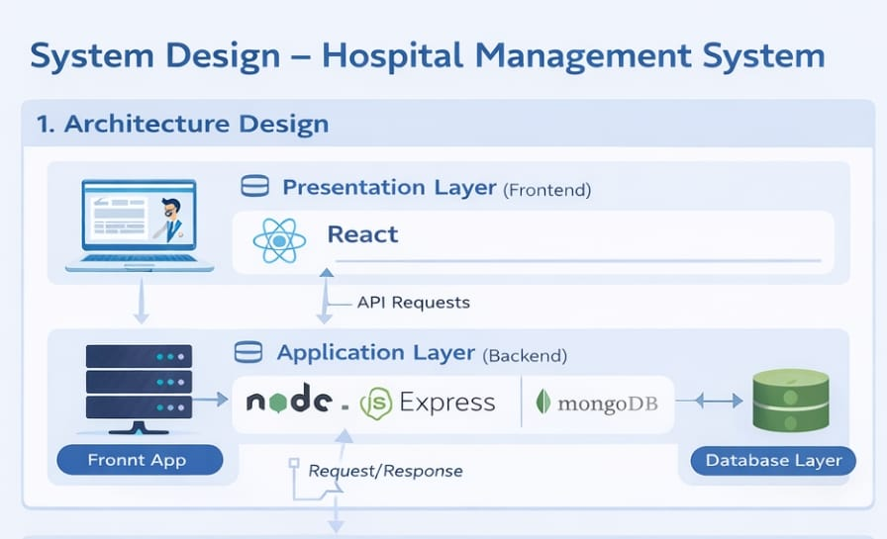
System Design

Slide 15
Technologies Used:
Frontend Implementation
The user interface is developed using React, HTML, CSS, and JavaScript.
It provides forms to add patient details, doctor information, and appointment data.
The frontend communicates with the backend using API requests.
Backend Implementation
The server-side application is developed using Node.js and Express.js.
It handles API requests from the frontend.
It processes user actions such as adding, updating, and retrieving hospital data.
Database Implementation
The system uses MongoDB to store and manage data.
Patient records, doctor information, and appointment details are stored in collections.
The database ensures secure and efficient data management.

Slide 16
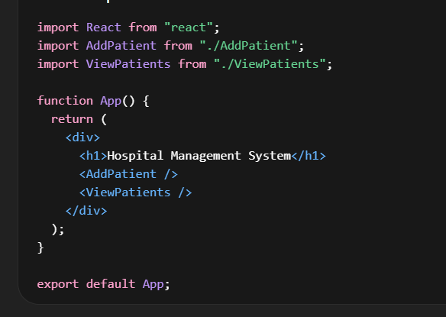
System Implementation

Slide 17
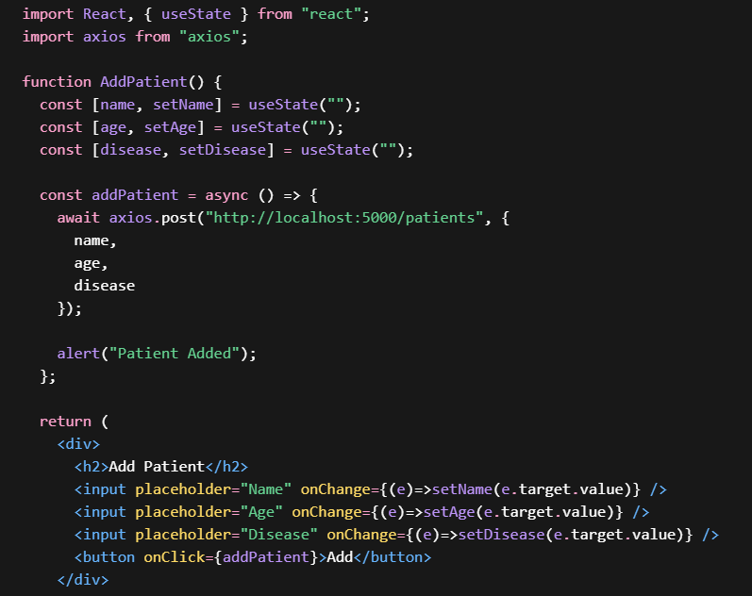

Slide 18
Internship Road Map
Note: Write in the below table what u will be achieving in each review
Review 1
Understanding the basic of web development introduction to html ,Structure of web pages.
Review 2
Designing the simple static web using html5,implementation forms, tables and multimedia elements, and following proper page.
Review 3
Introduction to CSS for Styling, applying colors, fonts,
layouts, and creating responsive designs for better user experience.
Review 4
Final Review
Learning basics JavaScript
for interacting ,implementing simple validation and improving webpages and functionality.
Developing a complete frontend Project ,interacting html, CSS and JavaScript, testing the website and presenting the final output with documentation.

Slide 19
Github Link
https://github.com/Ruchi612

Slide 20
Q&A

Slide 21
Thank you !!

